Slide 1

ANALYSTS BRIEFING PRESENTATION
2017 HALF YEAR FINANCIAL RESULTS
03.08.2017

Slide 2

OUTLINE
CBZ Holdings Limited Overview
Presenter – Never Nyemudzo, GCEO
Strategic & Operational Review
Presenter – Never Nyemudzo, GCEO
Financial Review
Presenter – Colin Chimutsa, GCFO
Dividend, Guidance & Outlook
Presenter – Never Nyemudzo, GCEO
Operating Environment Overview
Presenter – Never Nyemudzo, GCEO
2

Slide 3
GROUP OVERVIEW
Never Nyemudzo
Group CEO

Slide 4
OVERVIEW OF THE GROUP
.
US$2.2b in total assets (14% of GDP)
US$14b transactions in H1 2017 (35% of national transactions)
US$1.04b in loans & advances (27% of industry advances)
111 000 insurance policies (about 5% of insured population)
US$293m in bank shareholder funds (20% of industry total)
408 000 active bank accounts (13% of banked population).
US$82m remittances handled in 2016 (11% of official remittances).
Our market presence
4

Slide 5
OPERATING ENVIRONMENT OVERVIEW
Never Nyemudzo
Group CEO

Slide 6
NAVIGATING THE OPERATING ENVIRONMENT
SPECIFIC CONSTRAINTS
OUR RESPONSE
Cash and foreign currency shortages.
Constrained credit expansion.
Informalisation of the economy.
Constrained ability to plan for the long term.
Process reengineering to reduce, reorient & optimize costs.
Strengthening market presence.
Rehabilitating clients with future potential, strict credit granting and closer monitoring of borrower performance.
Business refocusing and reorientation.
Innovation to support business development.
New markets, e.g. regional expansion.

Slide 7
STRATEGIC & OPERATIONAL REVIEW
Never Nyemudzo
Group CEO

Slide 8
CAPITALISATION OF SUBSIDIARIES
8

Slide 9
CAPITALISATION OF SUBSIDIARIES
9

Slide 10
GROUP FINANCIAL PERFORMANCE REVIEW
Capital Adequacy
Minimum regulated 12.0%
Adequate buffer

Slide 11
DEPOSITS TREND
Achieved a growth of 215% since dollarization

Slide 12
LINES OF CREDIT
Continue to review cost of funds and project viability to enhance ex-post borrower performance

Slide 13
Quality of Earnings
NPLs Ratio – Managing Credit Quality
RBZ Threshold for NPLs - 5%

Slide 14
Quality of Advances
 | June 2017 | Dec 2016
Total net advances (US$m) | 1 043.1 | 1 007.2
Security value (US$m) | 1 828.2 | 1 706.5
Security cover (times) | 1.8 | 1.7
Provisions (US$m) | 64.5 | 60.8
Non performing loans (US$m) | 68.9 | 70.6
Coverage ratio (times) | 0.94 | 0.86
An increase of 7.1% is in in line with the loan book.
Target 100% coverage ratio on NPL

Slide 15
Quality of Advances - Security
 | June 2017 | Dec 2016
Total security value (US$ m) | 1 828.2 | 1 706.5
Comprised of:
Cash cover (US$ m) | 13.6 | 14.1
Collateral (mortgage security) (US$ m) | 870.0 | 932.0
Other forms of security including Notarial General Covering Bonds (NGCBs), cessions, etc. (US$ m) | 944.7 | 760.4

Slide 16
SEGMENT REPORTING JUNE 2017
 | Commercial Banking | Mortgage Finance | Insurance Operations | Asset Management | Property Management | Consolidated
Total Income (US$ m) | 62.8 | 13.7 | 5.2 | 1.0 | 0.02 | 80.5
Profit before tax (US$ m) | 10.0 | 0.8 | 2.3 | 0.1 | 0.1 | 12.0
Total assets (US$ m) | 1 967.0 | 186.1 | 36.7 | 3.1 | 10.4 | 2 159.0
16

Slide 17
CREDIT RATINGS
 | Jun 2017 | 2016 | 2015 | 2014 | 2013 | 2010
CBZ Bank | A | A | A | A+ | A+ | A+
CBZ Life | BBB+ | BBB+ | BBB+ | - | - | -
CBZ Insurance | BBB+ | BBB+ | BBB | - | - | -
CBZ Asset Management | A | A | A | - | - | -
17

Slide 18
INCOME DIVERSIFICATION

Slide 19
GROUP FINANCIAL PERFORMANCE REVIEW
19

Slide 20
MILESTONES ON STRATEGIC ROADMAP
Never Nyemudzo
Group CEO

Slide 21

UPDATE ON STRATEGIC INITIATIVES
INFRASTRUCTURE MARKET PRESENCE
  Bulawayo - Negotiations completed, and MOU signed, with the City of Bulawayo for the 670 medium density stands, US$7 million Mahatshula project.
  Marondera - Negotiations with key stakeholders completed for the 2 800 high density stands, US$15m project. Civil works to begin soon.
  Universities US$2 billion infrastructure project at feasibility stage.

Slide 22

UPDATE ON HOUSING PROJECTS
Our contribution towards national housing delivery.
PROJECT | PROJECT SIZE / TYPE | STATUS
Gweru - Mtausi | 368 stands. | Selling.
Gweru - Nehosho | 1 095 stands & housing units. | Selling.
Kwekwe - Mbizo | 415 stands. | Selling.
Harare - Westgate (Fairview) | Medium density stands | Selling.
Bulawayo - Mahatshula | 670 medium density stands. | Coming soon.
Marondera - Labor of Longlands | 2 800 stands. | Coming soon.
Harare - The Grange | 139 low density stands. | Sold out.
Victoria Falls | 1309 stands. | Sold out.
Mutare - Chikanga | 276 stands. | Sold out.
Harare – Highlands | Clusters houses. | Leased out.

Slide 23

UPDATE ON STRATEGIC INITIATIVES
SMES MARKET PRESENCE
  Expanding insurance solutions to include Employee Benefits business.
  Obtained regulatory approval and targeting to launch the following in H2:
    An innovative CBZ SME Pension Fund.
    Preservation Fund.
    Guaranteed Fund.
  These will complement banking solutions, and solidify our market presence in the SMEs sector.

Slide 24
UPDATE ON STRATEGIC INITIATIVES
COST MANAGEMENT
COST MANAGEMENT
  Continued to achieve positive from cost containment initiatives with CIR falling from 72.2% in June 2016 to 66.0% in June 2017.
  This was achieved through:
    Improved process efficiencies.
    Review of supplier contracts.
  Long term CIR target of 55-60% is within reach given the successes of the ongoing strategy to Reduce, Reorient & Optimize costs.

Slide 25
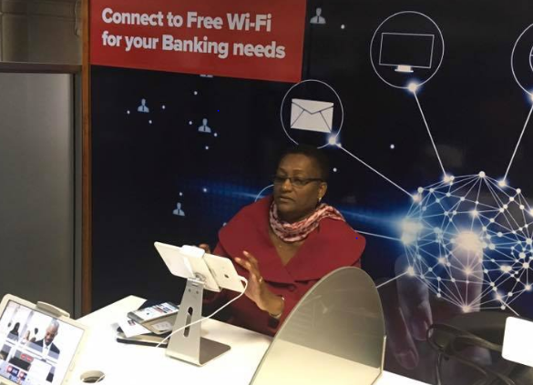
UPDATE ON KEY INNOVATIONS
DIGITAL BANKING - SELF SERVICE CENTRES
Giving our customers unprecedented freedom and options to transact.
Self service centres launched in Harare, Mutare, Masvingo, Gweru, Bulawayo and Chinhoyi – utilisation at 500 customers per day.
Launched WiFi hot spots in 36 branches.
This enables our customers to conveniently access our digital banking and social media platforms free of charge.
25

Slide 26
MILESTONES ON STRATEGIC INITIATIVES
20% increase in 6 months

Slide 27


THE BUSINESS IN NUMBERS…
No. of POS Machines
Dec 2016: 4 220
June 2017: 5 702
No. of Agents & Merchants
Dec 2016: 2988
June 2017: 4460
No. of Active CBZ Touch Users
Dec 2016: 37k
June 2017: 340k
+818%
+49%
+35%
No. of Accounts
Dec 2016: 370k
June 2017: 408k
No. of Policies
June 2016: 126k
June 2017: 111k
Remittances Transactions
H1 2016: 492k
H1 2017: 307k
+10%
-12%
-24%

Slide 28
FINANCIAL REVIEW
Colin Chimutsa
Group CFO

Slide 29
FINANCIAL MILESTONES
Statement of Financial Position
Prudential Liquidity Management
Profitability
Quality of Earnings
Subsidiaries’ Performance

Slide 30
GROUP FINANCIAL PERFORMANCE REVIEW
Consolidated Statement of Financial Position
 | 30 June 2017 ($m) | 31 Dec 2016 ($m) | Growth (%)
Total assets | 2 159.0 | 2 086.6 | 3.5
Total deposits | 1 822.9 | 1 777.2 | 2.6
Total advances | 1 043.1 | 1 007.2 | 3.7
Funds Under Management | 181.6 | 147.6 | 23.0
Total shareholders’ Funds | 293.3 | 283.1 | 3.6
30

Slide 31
GROUP FINANCIAL PERFORMANCE REVIEW
Deposits Mix
31

Slide 32
GROUP FINANCIAL PERFORMANCE REVIEW
Prudential Liquidity Management

Slide 33
GROUP FINANCIAL PERFORMANCE REVIEW
Consolidated Statement of Profit or Loss and other Comprehensive Income
 | 30 June 2017 $m | 30 June 2016 $m | Growth (%)
Net interest income | 39.7 | 38.6 | 2.8
Non interest income | 36.8 | 31.0 | 16.1
Underwriting income | 3.9 | 4.5 | (13.3)
Total income | 80.5 | 74.1 | 8.6
Total Expenditure | (53.1) | (52.9) | 0.4
Profit After Tax | 12.0 | 11.9 | 0.8
EPS (cents) | 4.6 | 4.5 | 2.2
33

Slide 34
FINANCIAL PERFORMANCE REVIEW
Interest Income Analysis
 | June 2017 | June 2016 | June 2015
Net interest margin (%) | 2.82 | 3.02 | 6.38
Write offs (US$ m) | 14.54 | 4.19 | 14.19
Provisions (including interest in suspense) (US$m) | 64.55 | 77.34 | 71.47
Non performing loans (US$ m) | 68.89 | 78.93 | 84.73
Non preforming loans (%) | 6.21 | 7.16 | 7.13
34

Slide 35
SUBSIDIARIES FINANCIAL PERFORMANCE REVIEW
CBZ Bank Summarised results
 | 30 June 2017 US $m | 31 Dec 2016 US $m | YTD% Growth
Total assets | 1 967.0 | 1 912.6 | 2.8
Shareholders’ funds | 171.7 | 166.6 | 3.1
Total advances | 827.8 | 874.0 | (5.3)
Total deposits | 1 771.9 | 1 735.4 | 2.1

Slide 36
SUBSIDIARIES FINANCIAL PERFORMANCE REVIEW
CBZ Life Summarized Results
 | 30 June 2017 US $m | 31 Dec 2016 US $m | YTD% Growth
Total assets | 19.6 | 19.3 | 1.6
Shareholders’ funds | 15.5 | 14.9 | 4.0
Money market assets | 15.6 | 14.4 | 8.3
Life Fund | 1.6 | 1.8 | (11.1)

Slide 37
SUBSIDIARIES FINANCIAL PERFORMANCE REVIEW
CBZ Insurance Summarized Results
 | 30 June 2017 US $m | 31 Dec 2016 US $m | YTD% Growth
Total assets | 16.6 | 12.5 | 32.8
Shareholders’ funds | 5.9 | 5.1 | 15.7
Insurance assets | 7.8 | 4.5 | 73.3
Money market assets | 5.9 | 6.4 | (7.8)

Slide 38
SUBSIDIARIES FINANCIAL PERFORMANCE REVIEW
CBZ Asset Management Summarized Results
 | 30 June 2017 US $m | 31 Dec 2016 US $m | YTD% Growth
Total assets | 3.1 | 3.0 | 3.3
Shareholders’ funds | 2.7 | 2.7 | -
Funds under management | 181.6 | 147.6 | 23.0

Slide 39
DIVIDEND POLICY
INTERIM DIVIDEND OF US$1.76 MILLION

Slide 40
GUIDANCE AND OUTLOOK
 | Y.T.D Growth June 2017 (%) | Forecast Growth Dec 2017 (%)
Total Assets | 3.5 | 3.3
Advances | 3.6 | 12.2
Deposits | 2.6 | 4.5
Funds under management | 23.0 | 30.0
Total Income (Y.O.Y) | 8.6 | 11.5

Slide 41
AWARDS & NOMINATIONS
Top Companies Survey 2017, 1st Runner Up - CBZ Insurance.
Global Finance Magazine - 30th Best Bank in Africa Award 2017.
Most Innovative Bank of the Year 2017 - Zimbabwe Digital Awards.
Best Mobile App of the Year - 2017 (CBZ Touch) – Zimbabwe Digital Awards.
Best Digital Financial Services Bank - Agent Banking and Digital Financial Services Awards 2017.
Best Bank Supporting MSMEs (ZNCC Mashonaland & Matabeleland Chapters and National Winner 2017).
2nd Runner Up - Business Sustainability Award (ZNCC 2017).

Slide 42
CSI & MAJOR EVENTS
-
Organized and hosted the Inaugural CBZ International SMEs Indaba
Donated a highway patrol ambulance to MoHCC (Ngundu Clinic)
Staff Volunteering
Refurbished the Paediatric Kitchen at Harare Hospital
42

Slide 43
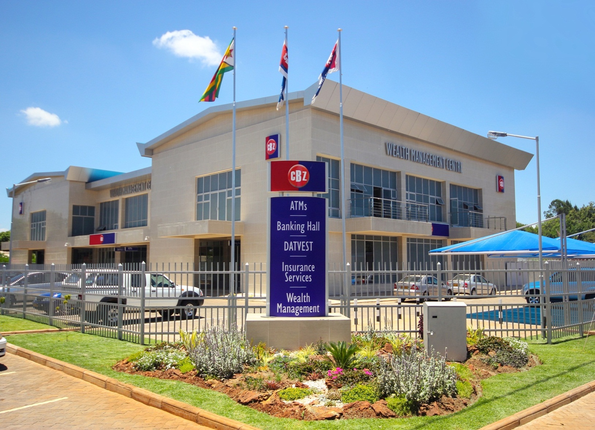
FOLLOW UP MEETINGS ON 8 AUGUST 2017 @ 15:00HRS

Slide 44

QUESTION & ANSWER SESSION
Don’t be left behind!
Open a CBZ Account, download the CBZ Touch from your app store now & transform your banking into a lifestyle…
44

